Slide 1
DESIGN PATTERN Strategy pattern
Author: Phu Dinh Nguyen
Supervisor: An Le

Slide 2
Agenda
Design Pattern introduction
Types of design pattern
Strategy pattern

Slide 3
Design Pattern introduction
Solutions for common problems in design.
Arrangement the interactions between individual software components.
Design patterns based on design principles.

Slide 4
Types of design pattern
Creational pattern
Structural pattern
Behavioral pattern
Solutions to instantiate a object
Solutions to create a class structure
Solutions for the better interaction between objects

Slide 5

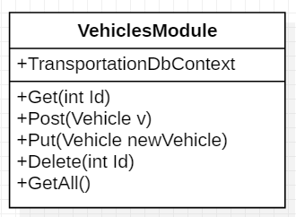
Strategy pattern
Situation:
Change database
=> Open close principle
Notes:
The behavior or the algorithm of object can be changed.

Slide 6
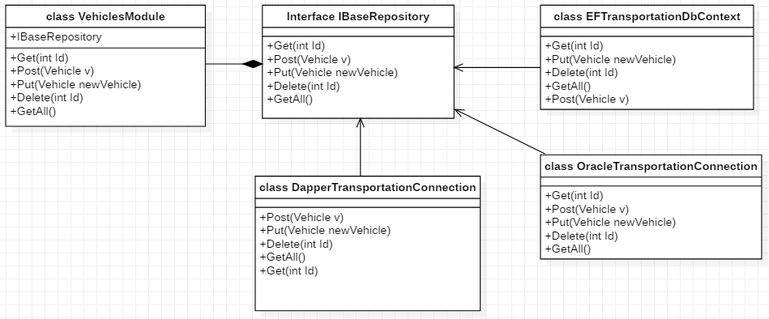
Strategy pattern
Solution:

Slide 7
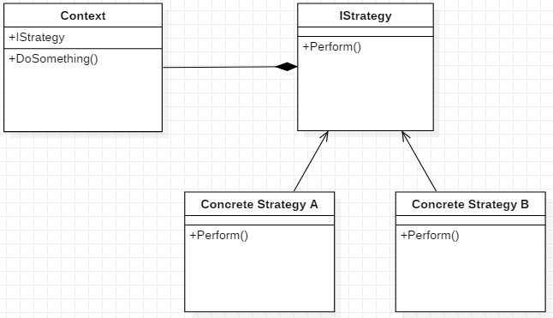
Strategy pattern
General Model:

Slide 8
Strategy pattern
Belong to behavioral pattern
Abide by “Open-close principle” and “Dependency inversion principle”
Easy for extensibility
Choice of implementation

Slide 9
References
Strategy (Anne Ryan)
“Design Patterns Library” course in Plural Sight (Scott Allen, John Sonmez, David Starr, Robert Horvick, Steve Smith, Brian Lagunas, Keith Sparkjoy, Donald Belcham, Niraj Bhatt, John Brown, and Glenn Block)

Slide 10
Thanks!
Any questions ?
You can find me at
Email: phudinhnguyen@kms-technology.com

